Slide 1
XGBoost Algorithm
Supervised Learning Classification

Slide 2
Agenda
Boosting Algorithms - XGBoost

Slide 3
Boosting

Slide 4
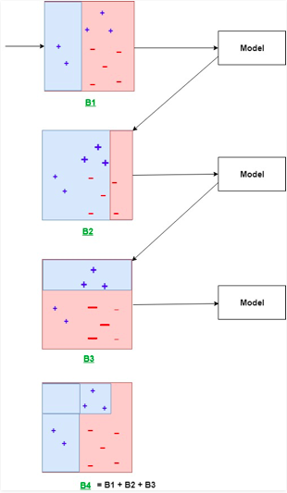
What is Boosting?
The ensemble of weak learners that learn sequentially
In each iteration weights of the samples are adjusted, such that the misclassified samples have a higher weight, therefore higher chance of getting selected to train the next classifier
Boosting reduces bias and variance
Here B1, B2 and B3 are base learners, and B4 is the boosting ensemble of weak learners

Slide 5
XGBoost

Slide 6
XGBoost
It is popularly said in the Machine learning world that, “When in doubt, use XGBoost”!
The two main reasons for the success and popularity of XGBoost are:
Execution speed - It is way faster when compared to other boosting implementations.
Model performance - It is the top performing algorithm for structured datasets for both classification and regression predictive modelling problems.

Slide 7
XGBoost
XGBoost is eXtreme Gradient Boosting
Developed at the University of Washington as a project
XGBoost is much faster than GBM
XGBoost is a combination of both, hardware and software optimization techniques, to provide better results using less computing resources in a short amount of time
XGBoost is designed to be used with very large and complicated datasets

Slide 8
XGBoost: key features
Similar to Gradient Boost
Regularization
A unique decision tree
Approximate Greedy algorithm
Weighted Quantile Sketch
Sparsity-Aware split finding
Parallel learning
Cache-Aware Access
Blocks for Out of Core Computations

Slide 9
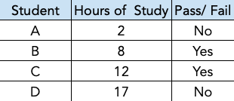
XGBoost: how it works
Sample dataset:
Target Variable: Pass
Independent Variables: Hours of Study

Slide 10
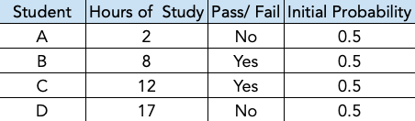
XGBoost: how it works
Step 1:
Just like GBM, XGBoost starts with a Leaf. XGBoost makes an initial prediction through this leaf
The initial prediction can be any value (target rate), by default it is 0.5
In this dataset the target rate is 0.5 i.e., there is a 50% probability for a student to pass
Initial prediction = 0.5
0.50
Initial leaf

Slide 11
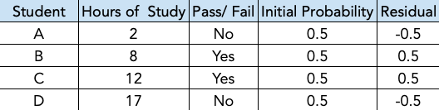
XGBoost: how it works
Step 2:
Calculate the Residual as:
Residuals show how good or bad the prediction is!

Slide 12
XGBoost: how it works
Step 3:
Build a tree for the residuals
Just like GBM, XGBoost fits a tree to the residuals. However XGBoost builds trees which are different from the trees built in GBM
Step 3.1:
Start as a single leaf. All residuals go to this single leaf
Note: There are many ways to build the tree. The most common way to build the XGBoost trees is discussed here.
-0.5, 0.5, 0.5, -0.5

Slide 13
XGBoost: how it works
Step 3.2:
Calculate the Similarity Score for the 1st leaf as per the below formula. Note: Since we do not square the residuals before adding them together, most of the large +/- residuals cancel out each other
It is a metric used by XGBoost to calculate the Gain. The variable/ threshold which gives the maximum gain is used to split the data
Here lambda (𝞴) is the Regularisation parameter used to enhance the stability and the accuracy of the model

Slide 14
XGBoost: how it works
Step 3.2:
Plugging in values, for the first leaf in the formula (on slide 72), Similarity = 0
-0.5, 0.5, 0.5,-0.5
Similarity = 0
Next, split the leaf into two groups, clustering similar residuals

Slide 15
XGBoost: how it works
Step 3.3:
Choose a threshold to split the leaf such that the gain will be the highest, for our example consider Hours < 14.5
The residuals for the 3 obs. less than 14.5, end up in the left child node
Similarity = 0
Hours < 14.5
Average = 14.5
-0.5, 0.5, 0.5
-0.5
Note: We can choose any value of `Hours` between 12 and 17 as a threshold, to obtain the maximum gain

Slide 16
XGBoost: how it works
Step 3.4:
Calculate the Similarity for left and right child nodes, using Similarity formula (on slide 72)
Similarity Score:
Left Child = ((-0.5+0.5+0.5)^2) / 3*(0.5*(1-0.5)
=0.25/3*0.25
=0.33
Right Child = ((-0.5)^2)/(0.5*(1-0.5))
=1
Hours < 14.5
Similarity = 0
-0.5, 0.5, 0.5
-0.5
Similarity = 0.33
Similarity = 1

Slide 17
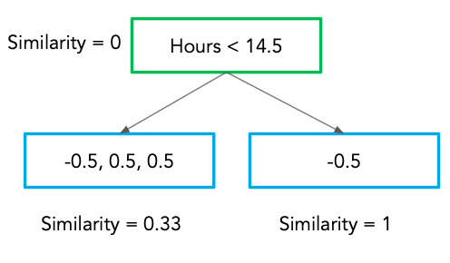
XGBoost: how it works
Step 3.5:
Calculate Gain for the branch as:
Gain helps XGBoost determine how to split the data
Plug in the values, Gain= 0.33+1-0 = 1.33

Slide 18
XGBoost: how it works
Step 3.5: Continued...
Similarly, XGBoost calculates Gain for split by other threshold values
The threshold which gives maximum Gain is chosen for the split
Here, threshold Hours<14.5, gives maximum Gain, hence it becomes the 1st branch of the tree

Slide 19
XGBoost: how it works
Step 3.5:
Next, split the residuals in the child nodes
Split residuals in the left node for threshold which gives the max Gain, for e.g.
Threshold Hours < 10, or
For Threshold <5

Slide 20
XGBoost: how it works
Hours < 10
Step 3.5: Continued…
For Threshold Hours < 10,
Gain = 0 +1- 0.33 = 0.66
Similarity = 0.33
-0.5, 0.5
0.5
Similarity = 0
Similarity = 1
(-0.5+0.5)^2/ 0.5*(1-0.5)=0
(0.5)^2/ 0.5*(1-0.5)=1
Gain = 0 + 1 - 0.33 = 0.66

Slide 21
XGBoost: how it works
Hours < 5
Step 3.5: Continued…
For Threshold Hours < 5, Gain = 1 + 2 - 0.33 = 2.66
As threshold for, Hours < 5 results in higher Gain, next split is basis this threshold
Similarity = 0.33
-0.5
0.5,0.5
Similarity = 1
Similarity = 2
(-0.5)^2/ 0.5*(1-0.5)=1
(0.5+0.5)^2/(2 * 0.5*(1-0.5))=2
Gain = 1 + 2 - 0.33 = 2.66

Slide 22
XGBoost: how it works
Step 3.5: Continued…
This is the 1st XGBoost tree
In this example we limit the tree to 2 levels
Hours < 14.5
Hours < 5
-0.5
-0.5
0.5,0.5

Slide 23
XGBoost: key concept
XGBoost limits the size of the trees by the following parameters:
XGBoost limits the level of trees, by parameter max_depth. It is the maximum number of levels in a tree. Default = 6
XGBoost continues branching the residuals in each leaf until it reaches the threshold for a minimum number of observations in a leaf, min_child_weight also, called Cover
Hours < 14.5
Hours < 5
-0.5
-0.5
0.5,0.5

Slide 24
XGBoost: key concept
The minimum number of residuals in a leaf are related to a metrics called Cover
It is the denominator of the similarity score, without 𝞴
Cover is dependent on the previously predicted probability for each residual in the leaf
The default value for cover is 1. Cover is equivalent to parameter -> min_child_weight
Cover

Slide 25
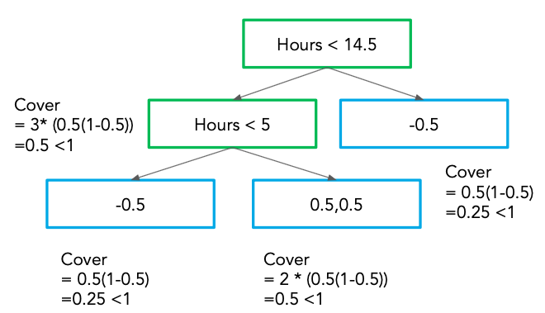
XGBoost: how it works
Step 3.6:
Compute cover for all leaf nodes, starting with the lowest branch
Compare with the default value of Cover =1
If cover for a leaf < Default Cover then, XGBoost would not allow those leaves
Cover for the leaves in this e.g. is <1. Hence, XGBoost would not allow these leaves, and we would be left with the Root node only
Hence for this e.g. we set Cover or min_child_weight = 0

Slide 26
XGBoost: key concept
𝞬 (gamma) is the Tree Complexity Parameter which helps in controlling overfitting by the tree
It is the minimum reduction in loss required to make a further partition on a leaf node of a tree
It is a user defined value and can be any value set by the user, e.g. 1, 2 etc
XGBoost prunes the tree by calculating the difference between Gain of lowest branch and 𝝲
If (Gain - 𝝲) is a positive number then it does not prune
If (Gain - 𝝲) is a negative number then it prunes the branch

Slide 27
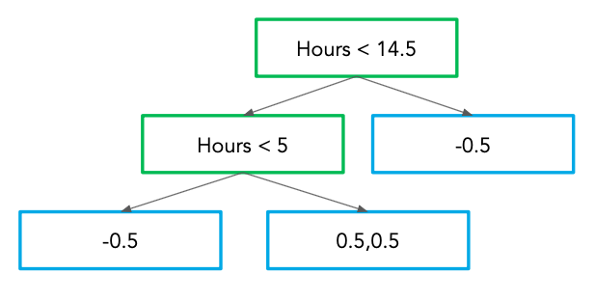
XGBoost: how it works
Step 3.7:
Prune the tree by calculating the difference between the Gain of the lowest branch and 𝝲 (gamma)
If (Gain - 𝝲) is a positive number then do not prune
If (Gain - 𝝲) is a negative number then prune the branch
If 𝝲 = 2 then the branch is not pruned as, 2.66 - 2 = 0.66 (Gain - 𝝲 is a positive value)
If 𝝲 = 3 then the branch is pruned as, 2.66 - 3 = -0.34 (Gain - 𝝲 is a negative value)
Gain for this node = 2.66

Slide 28
XGBoost: how it works
Step 3.8:
Calculate the Output value for each leaf of the tree as per the below formula.
This Output formula is the same as used in GBM, minus the Lambda (Regularisation Parameter)

Slide 29
XGBoost: key concept
𝞴 Lambda is the regularisation parameter
It reduces the Similarity Scores. Lower similarity scores lead to a lower value of Gain. So even smaller values of 𝞬 will result in a negative number and hence makes it easier to prune the tree
Values of 𝞴 greater than 0 reduce the sensitivity of the tree to individual observations

Slide 30
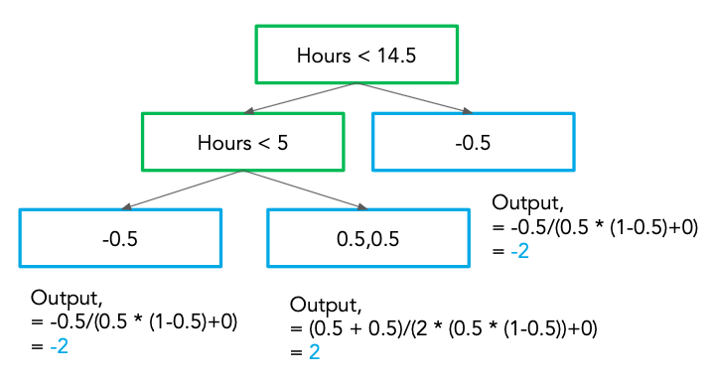
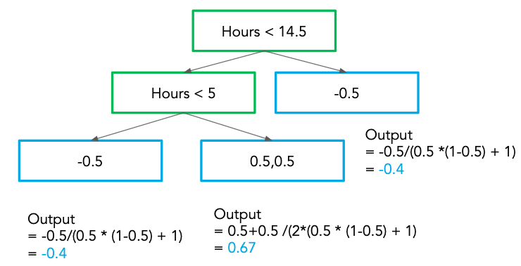
XGBoost: how it works
Step 3.8: Continued...
Notice the difference in the output values when 𝞴 = 0 and 𝞴 = 1
Output values are closer to Observed values when 𝞴 is greater than 0
𝞴=0
𝞴=1

Slide 31
XGBoost: key concept
When 𝞴 is greater than 0 it reduces the amount that a single obs adds to the new prediction. Thus it reduces the prediction sensitivity to isolated observation!
𝞴=0
𝞴=1

Slide 32
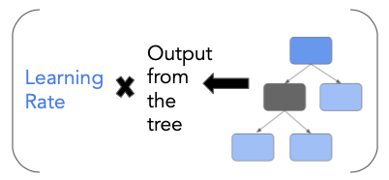
XGBoost: how it predicts
Initial Leaf
ε
Like GBM, XGBoost makes a new prediction by adding the predictions from each tree to the initial prediction
The output from each tree is scaled by a Learning Rate ε (Eta). By default it’s value is 0.3
ε

Slide 33
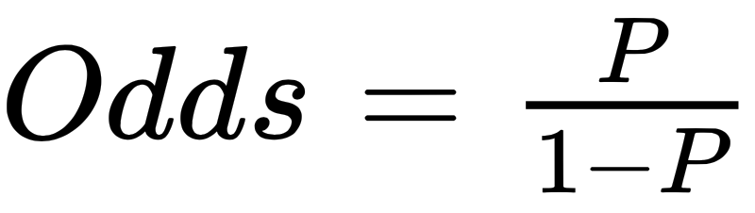
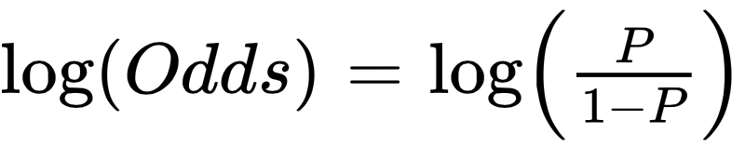
XGBoost: how it works
Step 4: Predict
XGBoost makes a new prediction by starting with the initial leaf
Convert the initial prediction to log(Odds)
As we know,
log(Odds) of Initial Prediction = log(0.5/(1-0.5)) = Log(1) = 0
Initial leaf
0.50
∴

Slide 34
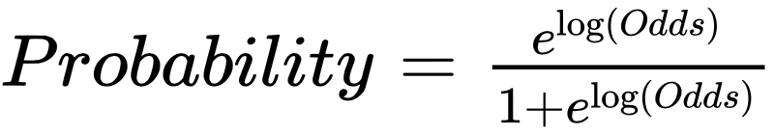
XGBoost: how it works
Step 4: Continued…
Add the output from 1st tree, scaled by learning rate to the initial prediction
Convert Log(Odds) prediction to probability, using the below formula:
Initial leaf
0.50
Output = 0

Slide 35
XGBoost: how it works
Step 4: Continued…
Taking the example of the left-most leaf, Prediction = 0 + 0.3 * - 2 = - 0.6
Convert this log(Odds) prediction to probability, so new predicted probability = 0.35
Observed Value for this leaf was 0
Initial Prediction from the leaf was 0.5
New Prediction after adding the output from the 1st tree is 0.35
Thus, taken a small step in the right direction!
Initial leaf
0.50
Output = 0

Slide 36
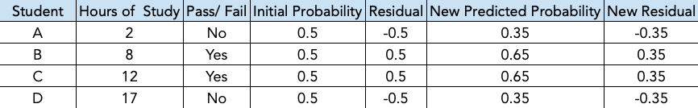
XGBoost: how it works
Step 5:
Similarly, compute the prediction for other leaf nodes
Notice that the new residuals are smaller than the previous residuals
XGBoost will build a new tree to fit the new residuals

Slide 37
XGBoost: how it works
Initial leaf
2nd Tree
0.50
XGBoost keeps building trees until the residuals are very small or it has reached the maximum no. of trees specified.
Hours < 5
-0.5
Output = -2
-0.5
0.5,0.5
Output = -2
Output = 2

Slide 38
Why eXtreme Gradient Boost?
According to the authors of ‘xgboost’ it ”automatically does parallel computation on a single machine which could be more than 10 times faster than existing gradient boosting packages”
XGBoost scales beyond billions of examples using far fewer resources than existing systems
In the words of Tianqi Chen,
“The name xgboost, though, actually refers to the engineering goal to push the limit of computations resources for boosted tree algorithms.”
“A more regularized model formalization to control over-fitting, which gives it better performance”

Slide 39
Read about:
LightGBM framework released by Microsoft Research
CatBoost developed by Yandex Technology

Slide 40
Thank You

